Slide 1
Model View Control Architecture

Slide 2

Happy Graduation
It is the season of graduation !

Slide 3
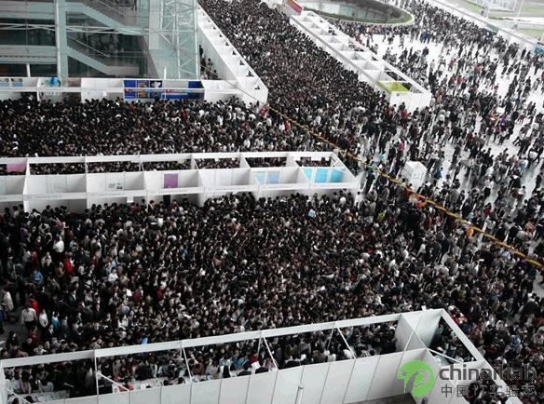
畢業即失業!!?
I hope not

Slide 4
Let’s take a look at tech Job Interview
http://www.youtube.com/watch?v=2cf9xo1S134

Slide 5
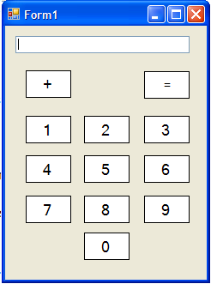

My interview question: How do you plan to write an simple calculator

Slide 6
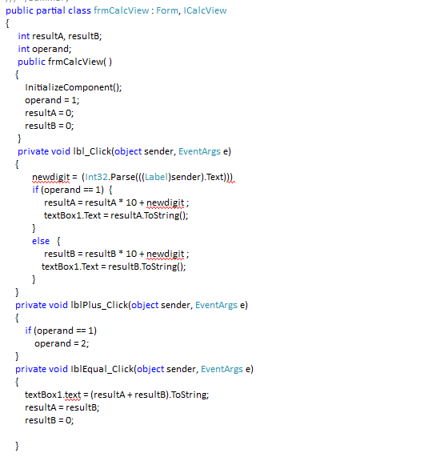
First Intuitive Implementation in C#
Directly manipulate GUI output

Slide 7

GUI Changes
GUI is the most unstable components in software
Hey, give me a console calculator
I don’t like using mouse to click button

Slide 8

GUI Changes (Your beautiful OL colleague )
人家每天都要處理很多數字的運算
GUI 的計算機不好用啦!~~~~
請你設計一個善用右邊鍵盤的程式
下班陪你吃飯喔!

Slide 9
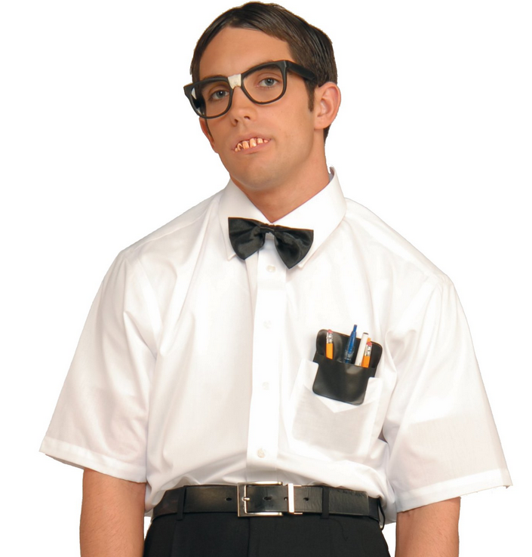
Sometimes, requirement change!!
Hey ! Rookie
Your calc is too simple. I want to extend it to engineering usage with floating point

Slide 10
What’s wrong with your code?
Computation logic is mixed with UI code
You UI code depends on your kernel code and vice versa
When UI changes, you need to open your whole program and modify it. It violates the open for extension and closed for modification principle.

Slide 11
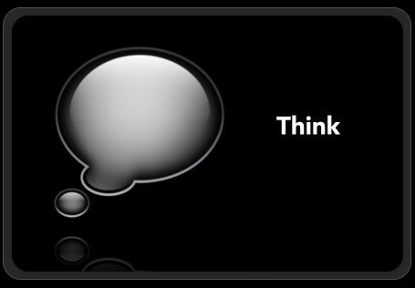
OK
Before I give the answer directly
Let’s discuss how you attempt to address the problem using all the knowledge you have learned in this class.
Let’s think
and discuss

Slide 12

Instead of teaching by my own, I want
You guys divided into groups
Let’s hear proposal from each group
Let’s see if we can come up
a close solution from your
wisdom using what you
have learn in class. (hint. The abstract technique)

Slide 13
MVC – model view control
The king pattern (paradigm, or architecture)
Model – the computation model (computation logic handler)
View – the entity that render the data into visualization objects.
Controller – the entity that deals with user events – interpret user’s actions and decide how to interact with model

Slide 14
What the heck is a “MODEL”?
Recall the data object in the weather forecast app in Observer design pattern?
Not a very precise term. Often has specific meaning depending on the domain and context.
Let’s look at what is a “data model” in visualization in Visualization research.
The model here include additional methods to change and control the set of of the data.

Slide 15
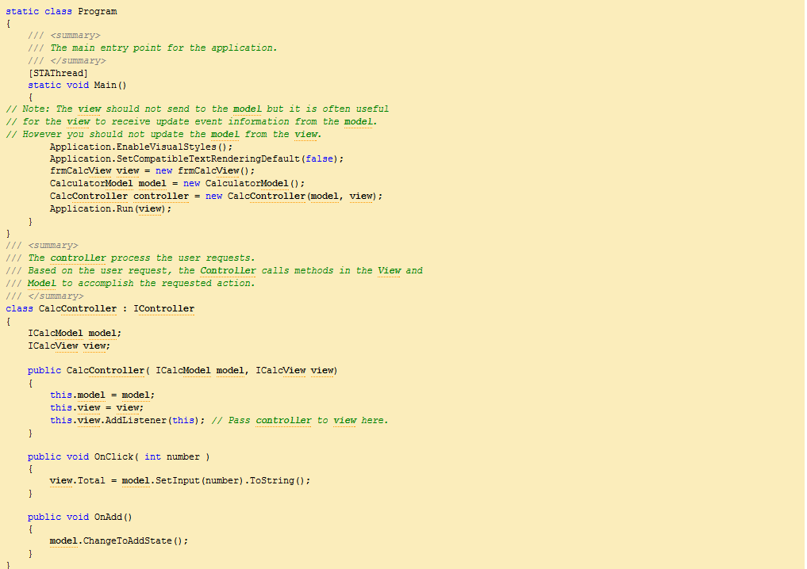

Slide 16
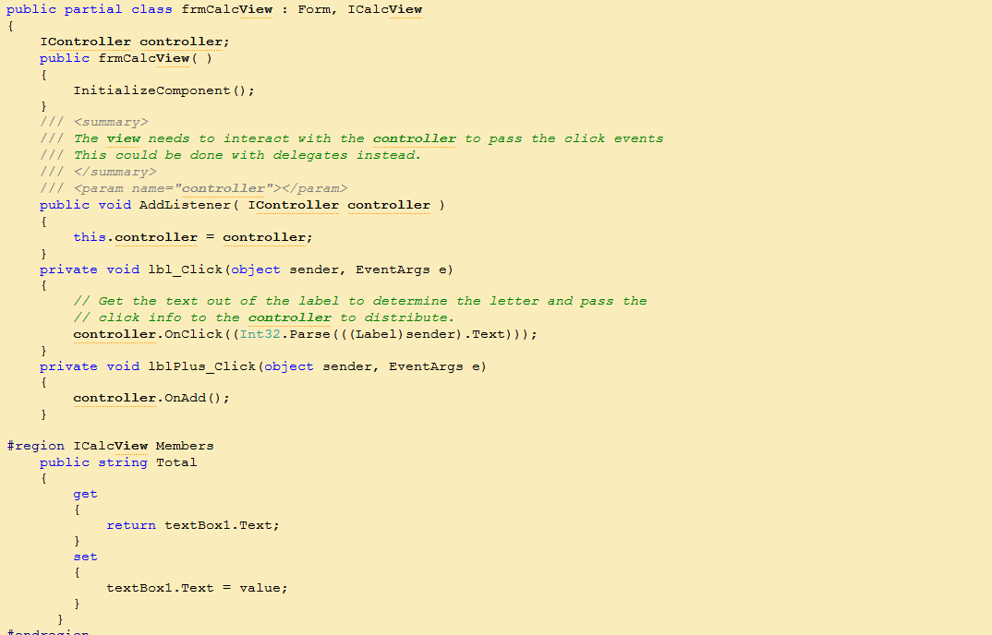

Slide 17
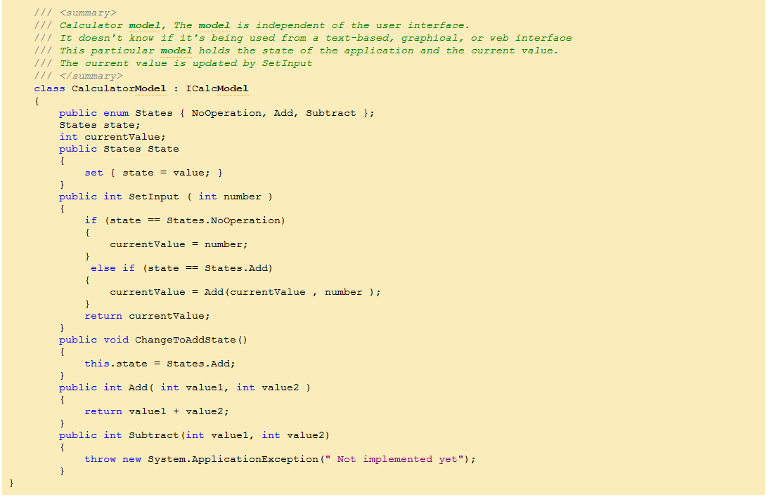

Slide 18
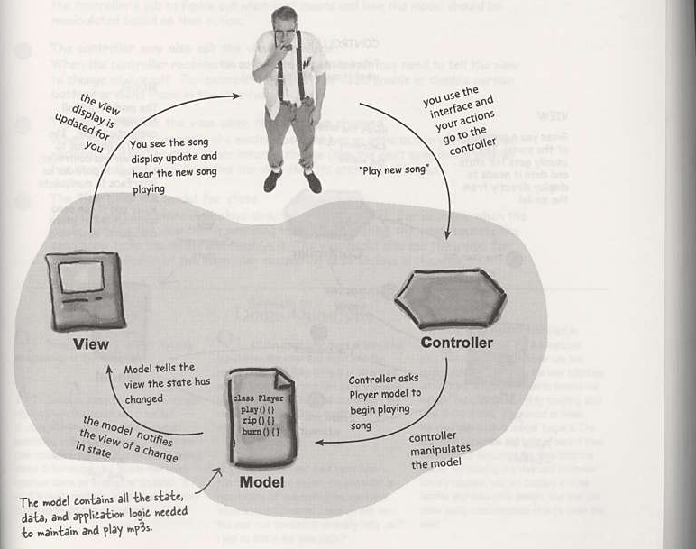

Slide 19
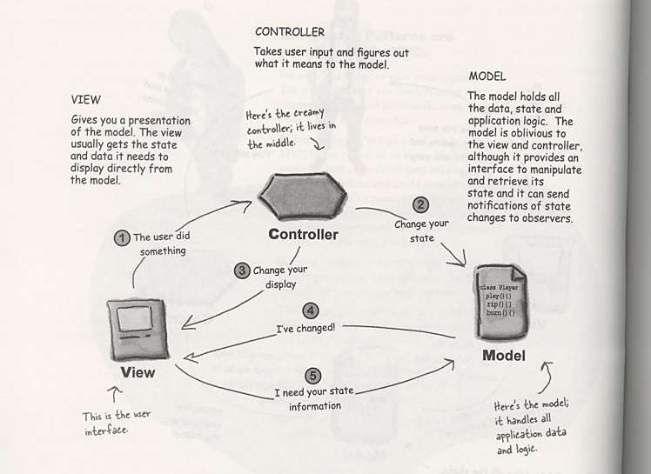

Slide 20
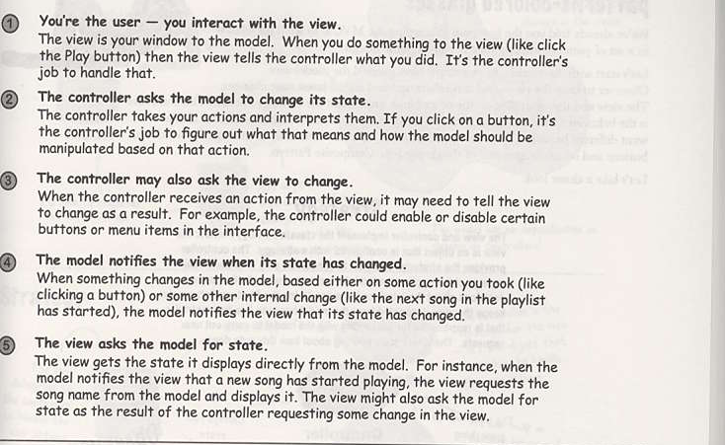

Slide 21
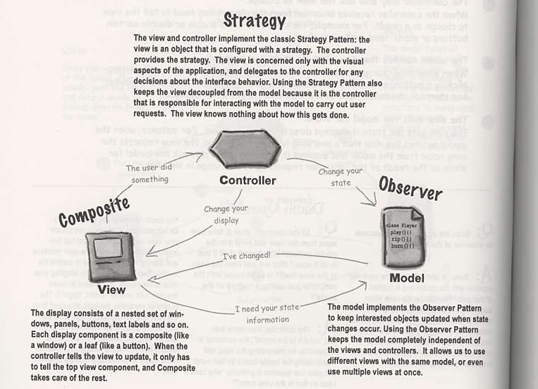

Slide 22
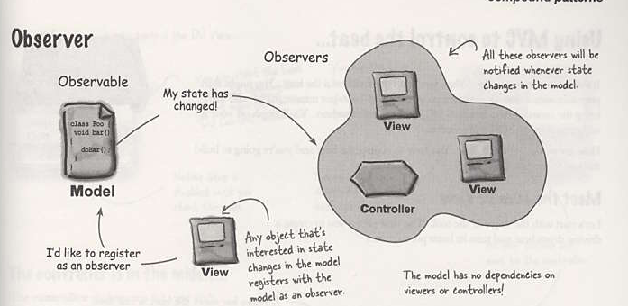
More detailed explanation

Slide 23
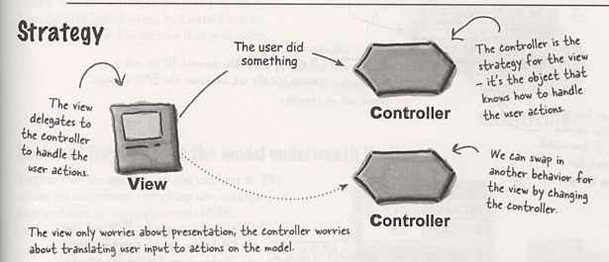
Controller interprets the GUI events, which can be changed

Slide 24
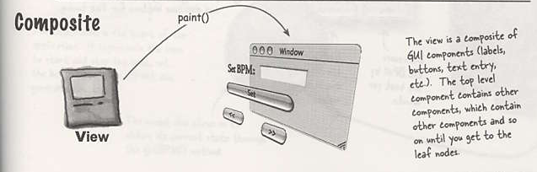
The View is responsible for painting the view

Slide 25
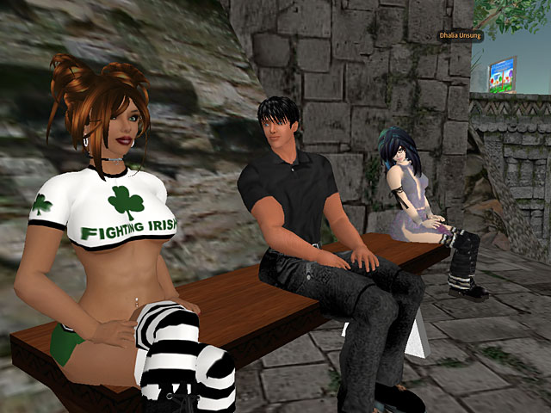
When do you want to change a controller?
Second Life
Example 1:
When you drag the mouse with right mouse button, the camera is rotate by the difference you drag.
However, after usability test, You found users are usually not good at right button and mouse scroll button. They found it difficult to use

Slide 26
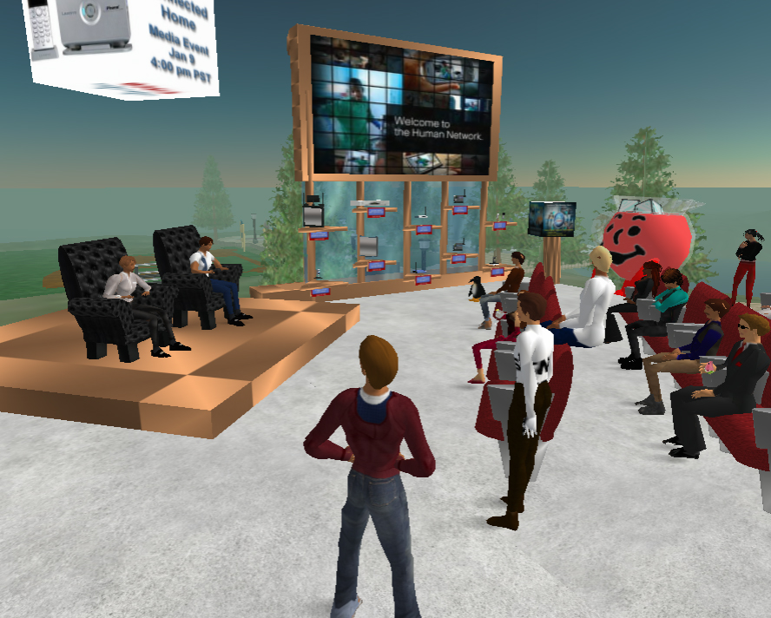
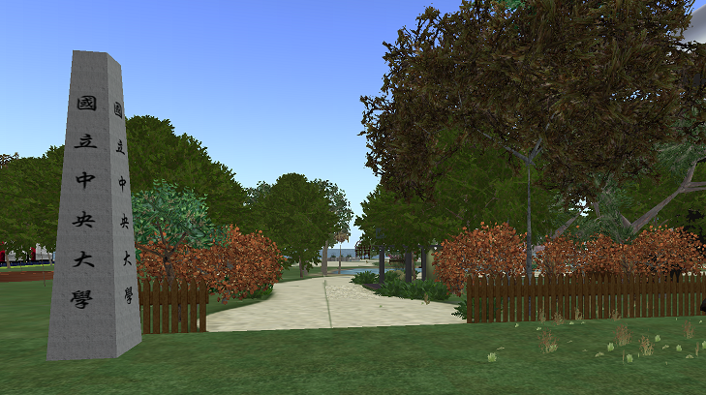
It’s time to change controller
Second Life
So, your UI need to redesign
you want to get rid of right mouse button

Slide 27
What is Usability Test ?

Slide 28
Some facts
Most programmers do not possess the knowledge in UI design
Programmers often think UI is not a difficult part, which is wrong in practice, especially in commercial products
Change UI design (e.g., making UI more friendly) often means writing a lot more code, which is not expected.
Programming tasks are often spec-oriented, not user oriented.

Slide 29
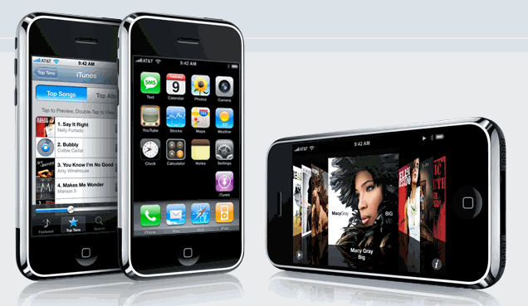

Slide 30
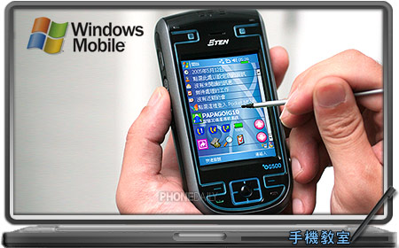
The failed story

Slide 31
Why Microsoft lost its markets?
UI
UI
UI
UI
…..

Slide 32
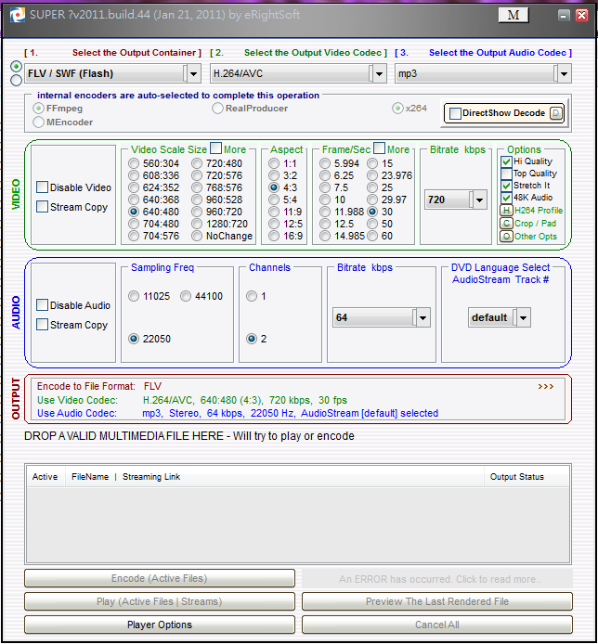
Powerful tools made for Geeks

Slide 33
Goals of usability tests
Performance -- How much time, and how many steps, are required for people to complete basic tasks? (For example, find something to buy, create a new account, and order the item.)
Accuracy -- How many mistakes did people make? (And were they fatal or recoverable with the right information?)
Recall -- How much does the person remember afterwards or after periods of non-use?
Emotional response -- How does the person feel about the tasks completed? Is the person confident, stressed? Would the user recommend this system to a friend?

Slide 34
Some usability test method
Think aloud protocols
Users are asked to say whatever they are looking at, thinking, doing, and feeling, as they go about their task.
Observers at such a test are asked to objectively take notes of everything that users say, without attempting to interpret their actions and words.
Test sessions are often audio and video taped so that developers can go back and refer to what participants did, and how they reacted. The purpose of this method is to make explicit what is implicitly present in subjects who are able to perform a specific task

Slide 35
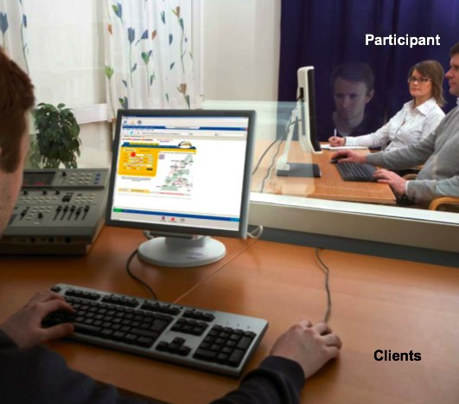
Eye tracking

Slide 36
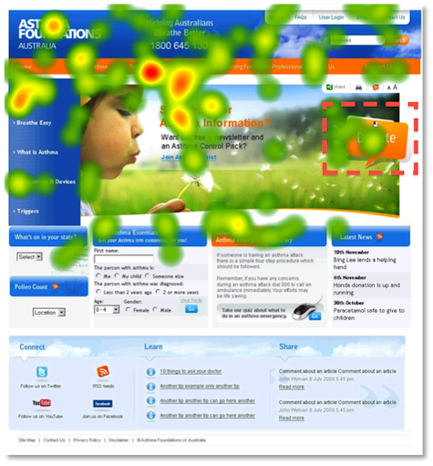
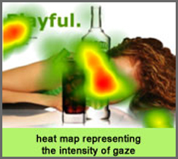
Eye tracking pattern

Slide 37
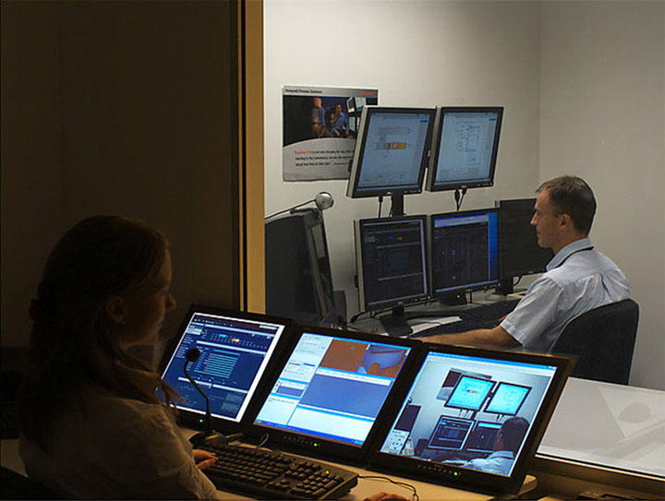
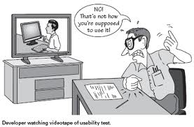
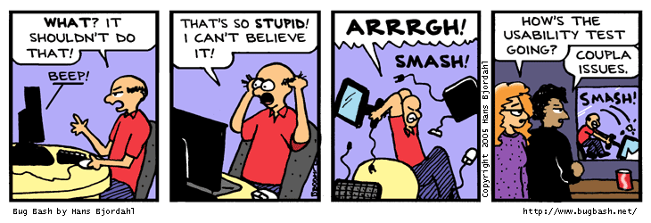
Investigation room

Slide 38
Why you want to change view
In nowadays, typical platform you need to support may include
Window 7, XP
Mac OS
Linux
Chrom OS (in the air)
The real world is never being easy and kind to programmers

Slide 39
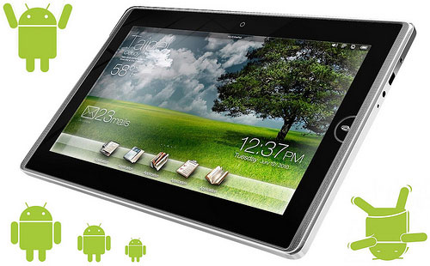
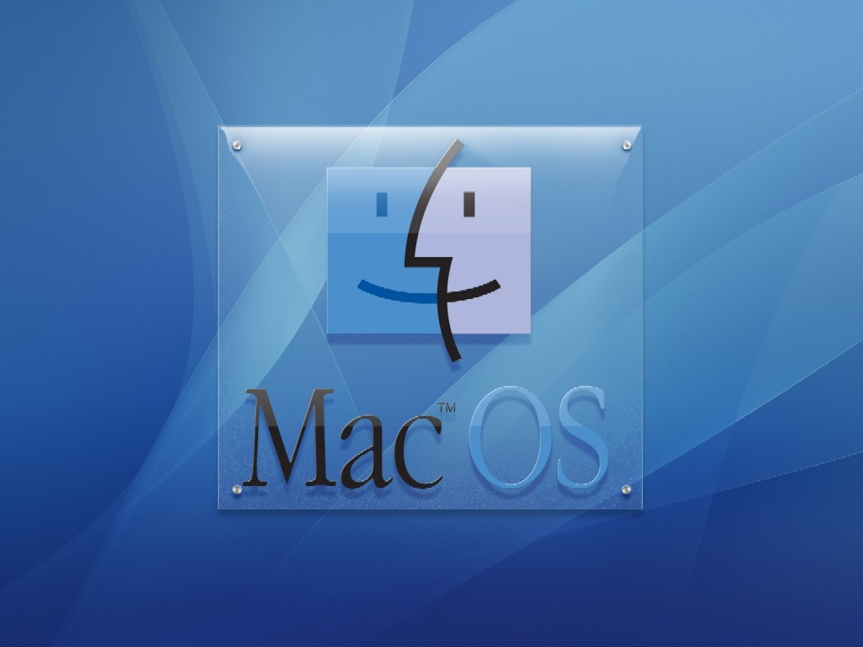
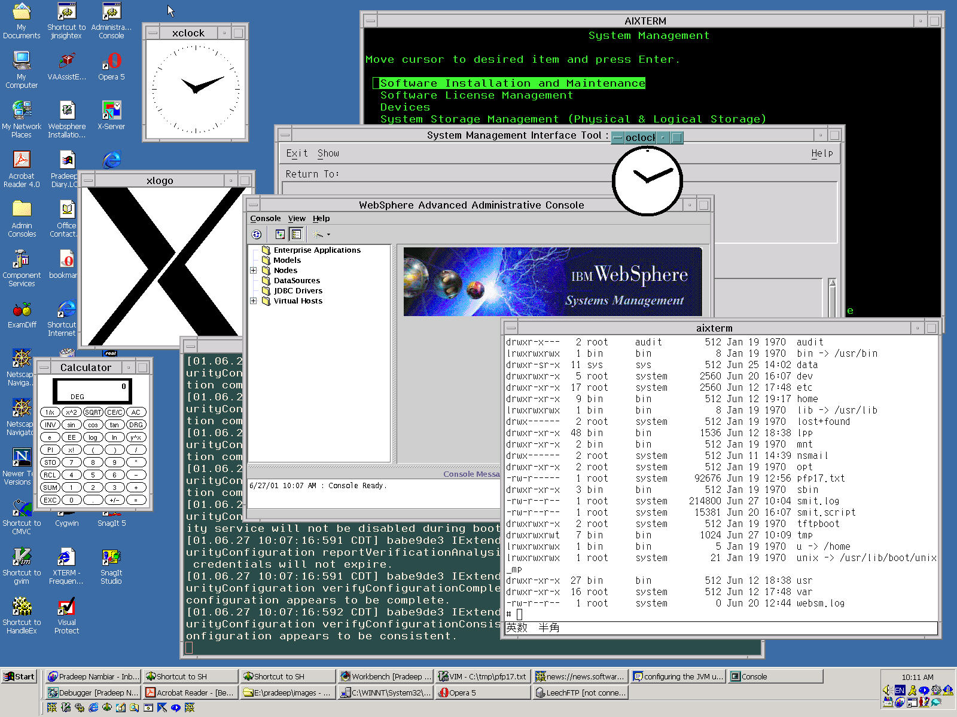
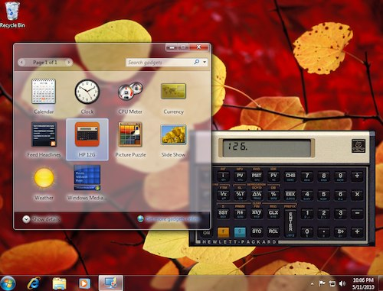
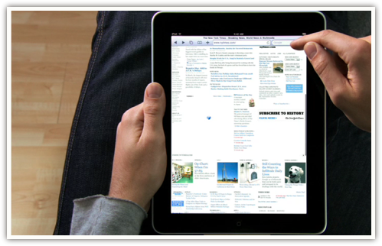
View May changes
OK unending torture.
now Android Pad !!
Its Window 7 !!
WOW Its MAC OS!!
WOW Its X window !!
for GEEK
What? Pad with
multi-touch? If you don’t support it
You are 落伍了

Slide 40

OK, I give up
I will go back to write all applications in web and get rid of platform dependency

Slide 41
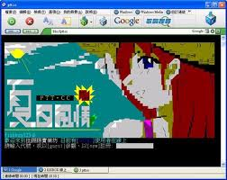


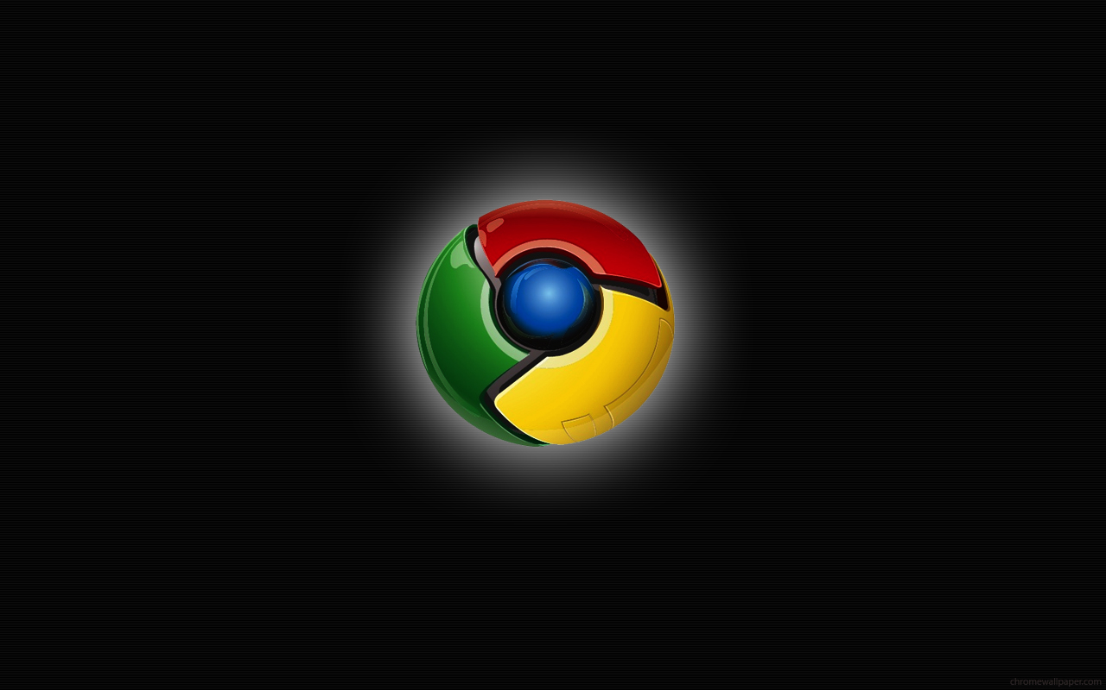

STILL

Slide 42
Including the PL, framework choice
PHP, AJAX, Ruby on rails, ASP, JSP…..

Slide 43
Some NOTES
So far, many apps are still difficult to be deployed on web.
UI efficiency is the main concern.

Slide 44
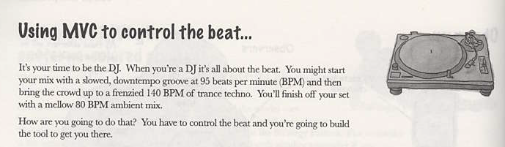
Back to MVC

Slide 45
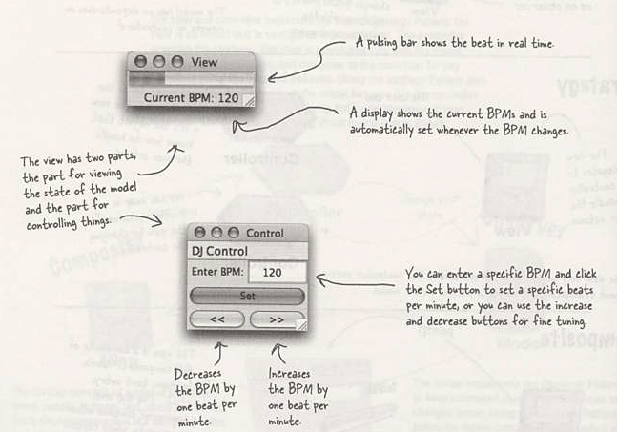
Tool views

Slide 46
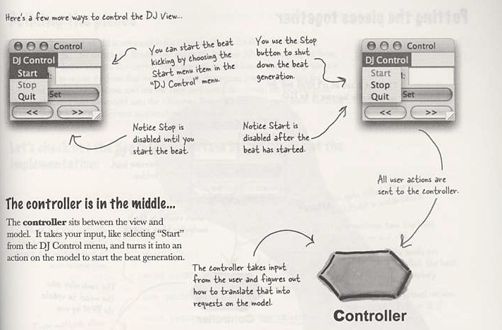

Slide 47
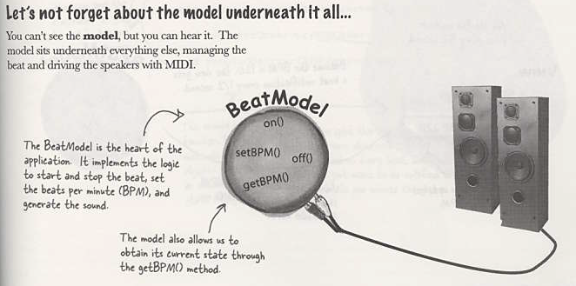
Model

Slide 48
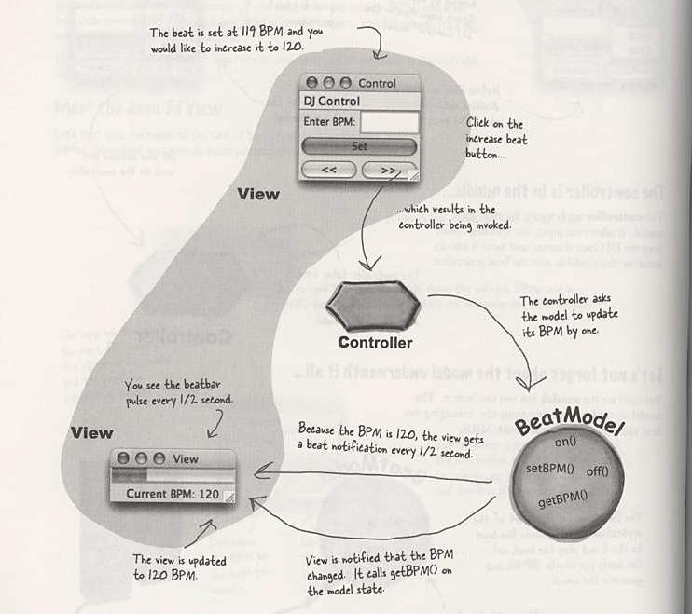
Put all together

Slide 49
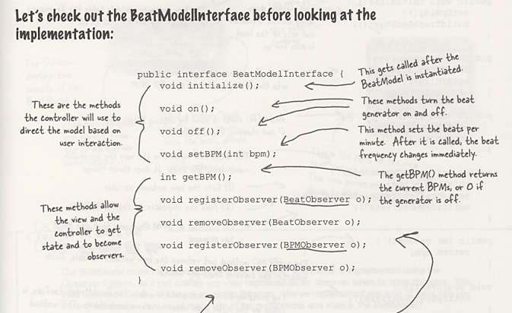
Model interface

Slide 50
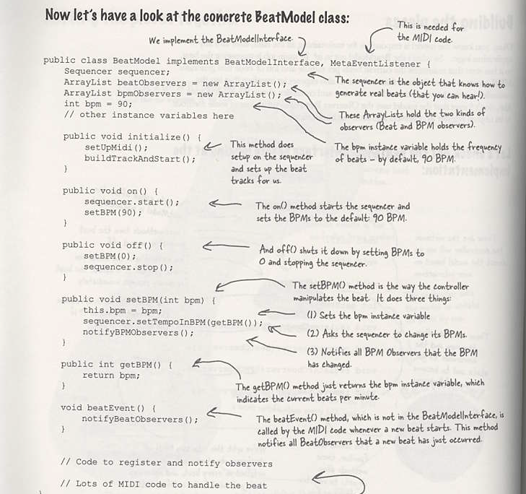

Slide 51
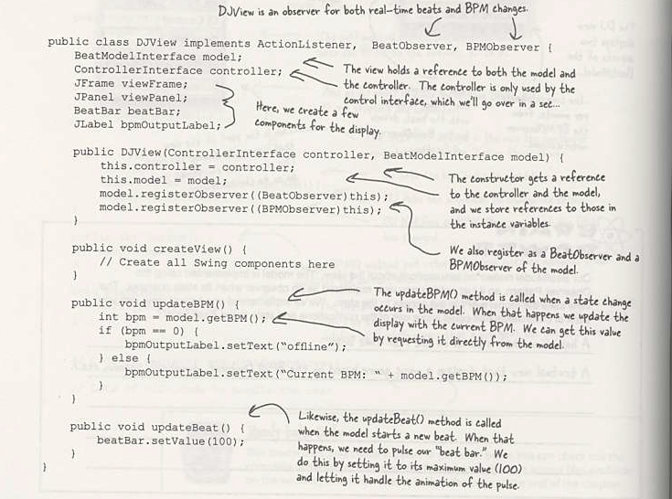

Slide 52
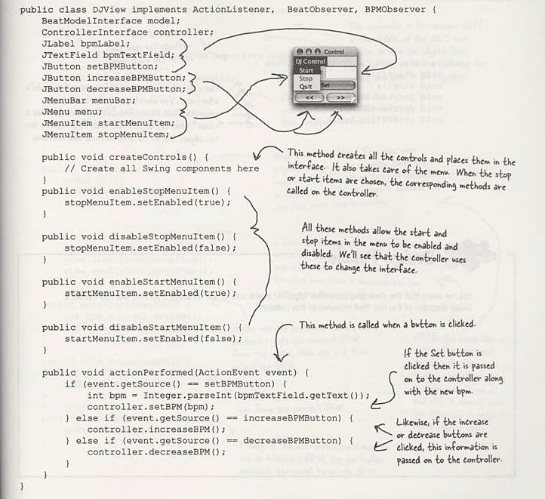

Slide 53
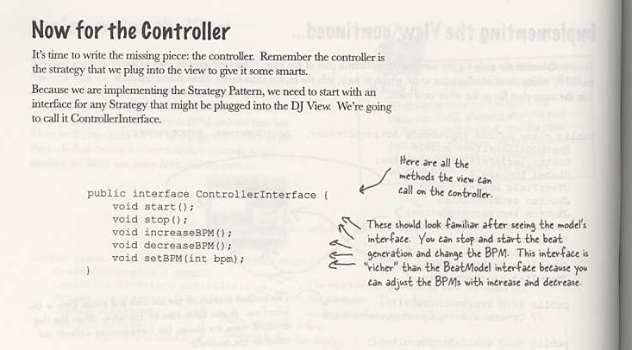

Slide 54
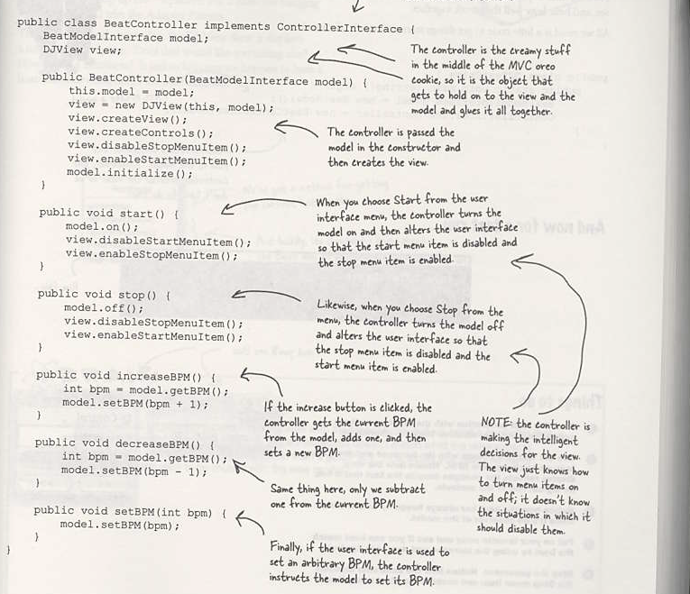

Slide 55
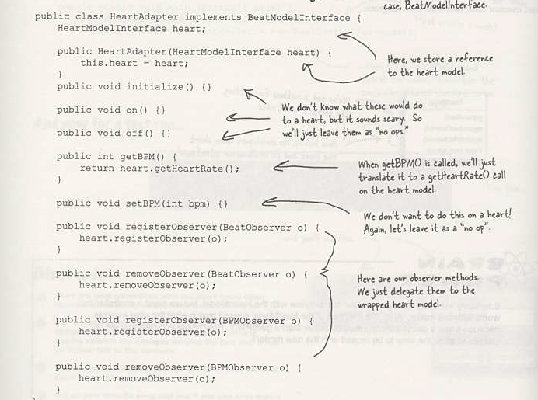
Adapt the model to reuse view

Slide 56
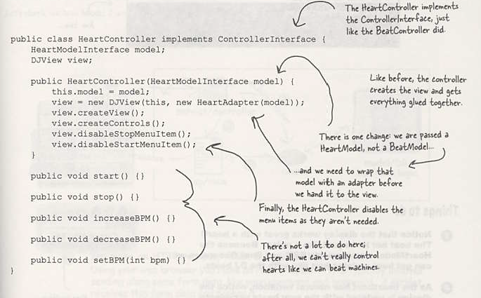

Slide 57
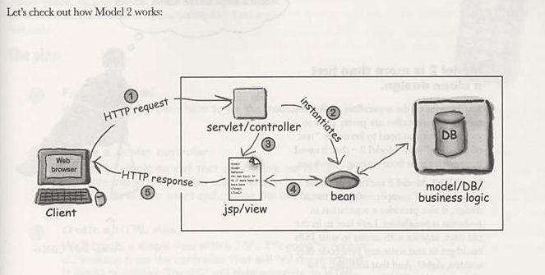
MVC and the web

Slide 58
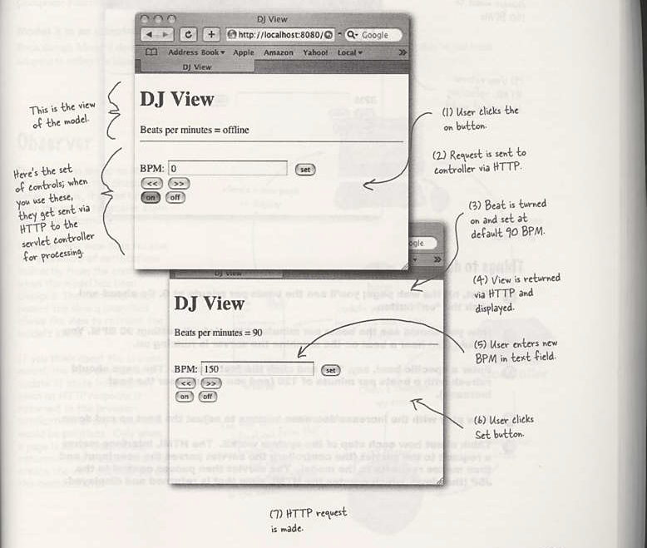
Last Challenge !! Change your program to adapt web view and controller

Slide 59
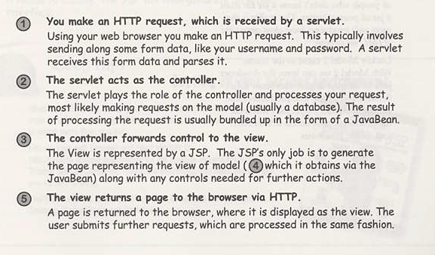

Slide 60


Slide 61




Slide 62



Slide 63


